Slide 1
Work Together
with git

Slide 2

Massive Freedom Software World Let us work together
GitHub: Thousands of projects for biology and medicine
Statistics
Visualization
Machine Learning techniques
Our OMICS class

Slide 3
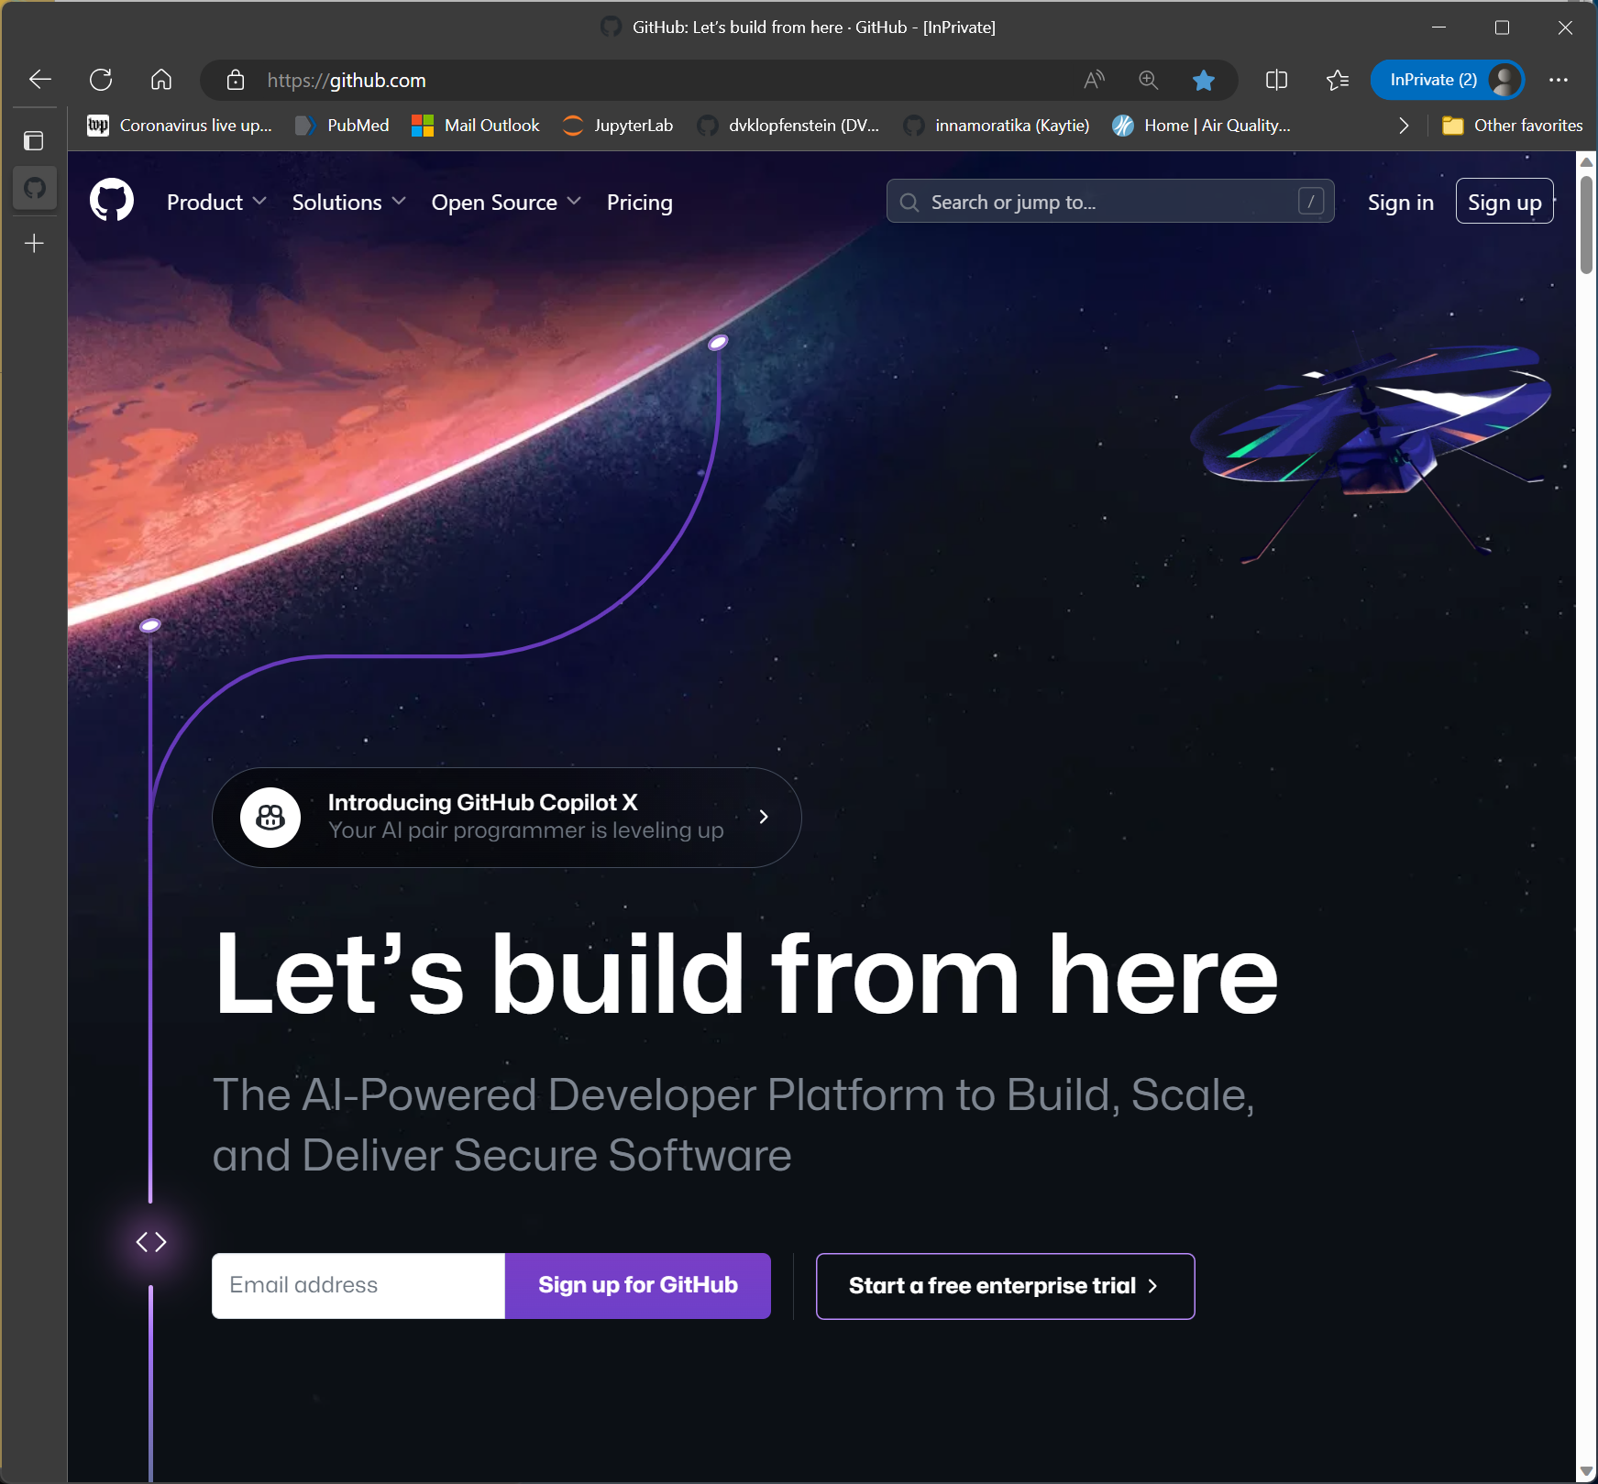
GitHub
100 million users and growing
Protect your work with version control (git)
Work together
Free Open Source projects:
Sequencing
Plotting
Scientific computing
Many more!

Slide 4
Collaborate with worldwide researchers
How many of your colleagues are NOT LOCAL?
How often do you work with local/remote colleagues?
It is FUN to work with people from all over the world
It is AFFORDABLE to work with anyone in the world

Slide 5
How to work with colleagues
How to work with remote and local colleagues using
version control
Notes:
What do you think version control is? Have you used it before? (try to get about 5 min of discussion)

Slide 6
Version Control -- Discuss:
What do you think "version control" is?
Have you used it before?
What is a "version" of a file?
How are versions "controlled"?

Slide 7
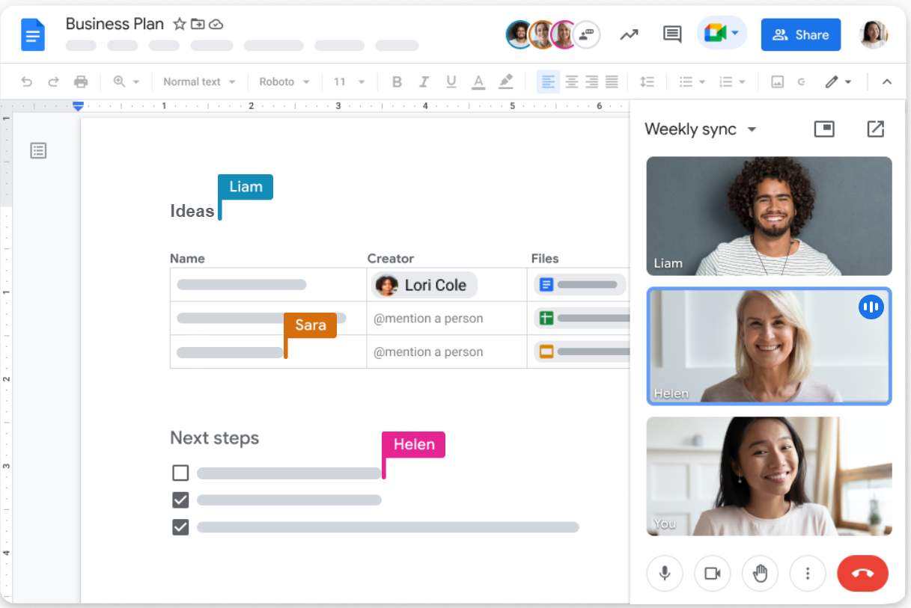
Google Docs
Multiple people can edit
Tracks versions
Work together

Slide 8
Google Docs vs. GitHub
Google Docs
GitHub
Micro versions silently saved automatically
People see your edits as you work as if they were looking over their shoulder
People can edit your work while you are working
You are always sharing your work no matter what
You control when you save versions
You describe each version
You work in peace with no one looking over your shoulder while you work
Only when you are happy with your work, you share it
Only see other people's edits when convenient for you

Slide 9
What is git version control?
Protect your work
Recover deleted files
Reverse bad edits
Track your progress
Keep everything in one place
Work on projects with colleagues
Fun!
Use researchers tools they built for their own projects
Build better projects together
Affordable: Free with a student email; $4/month otherwise
Notes:
Slide 2: So you want to do research?
Scientific Method:
Observation
Question
Hypothesis
Experiment <- You did Flow Cytometry
Analyze data <- You are here
What if you don't want to work on flow data by yourself
Imagine that you've been talking to your colleagues
You other colleagues are analyzing their data, but you won't
How do we all work together? (Here is where git comes in)
What is GItHub? We can all work together on the same project. We can all use the same software
Google docs for science (see previous edit history. You can bring back old versions)
GitHub has that too, but instead of a document, we are building and using tools together.
Now imagine you can't see each other
Someone is peering over your shoulder knit-picking
Instead, you can work in peace until your work is ready. You can get updates that other people have made
Segways:
6-7
https://www.tmcnet.com/voip/news/articles/446560-understanding-internet-connection-options.htm

Slide 10
OMICS class repository
https://github.com/DamLabResources/OMICS
Notes:
Have everyone navigate to the site- take a look around. What do you see?
Spend 5 minutes navigating this repository or repo-
Scav hunt:
Who are the instructors?
Is there a group project?
Where is the content for each week?
What does grading consist of?
What happens if you click on the "fork" button?
What is in the README file?

Slide 11
GitHub Scavenger Hunt https://github.com/DamLabResources/OMICS
Who are the instructors for this course?
Is there a group project?
Where is the content for each week?
What does grading consist of?
What is in the README file?

Slide 12
Vocabulary of git: Eight words
Repo
Fork
git clone
git commit
git status
git diff
git push
Pull Request (PR): Very Prestigious. Resume worthy

Slide 13
Repository (repo)
Repository:
Place, room, or container where something is deposited or stored (Merriam-Webster)
A repository contains all your project's files and each file's revision history (docs.github.com)
"Repo" is short for "repository"

Slide 14
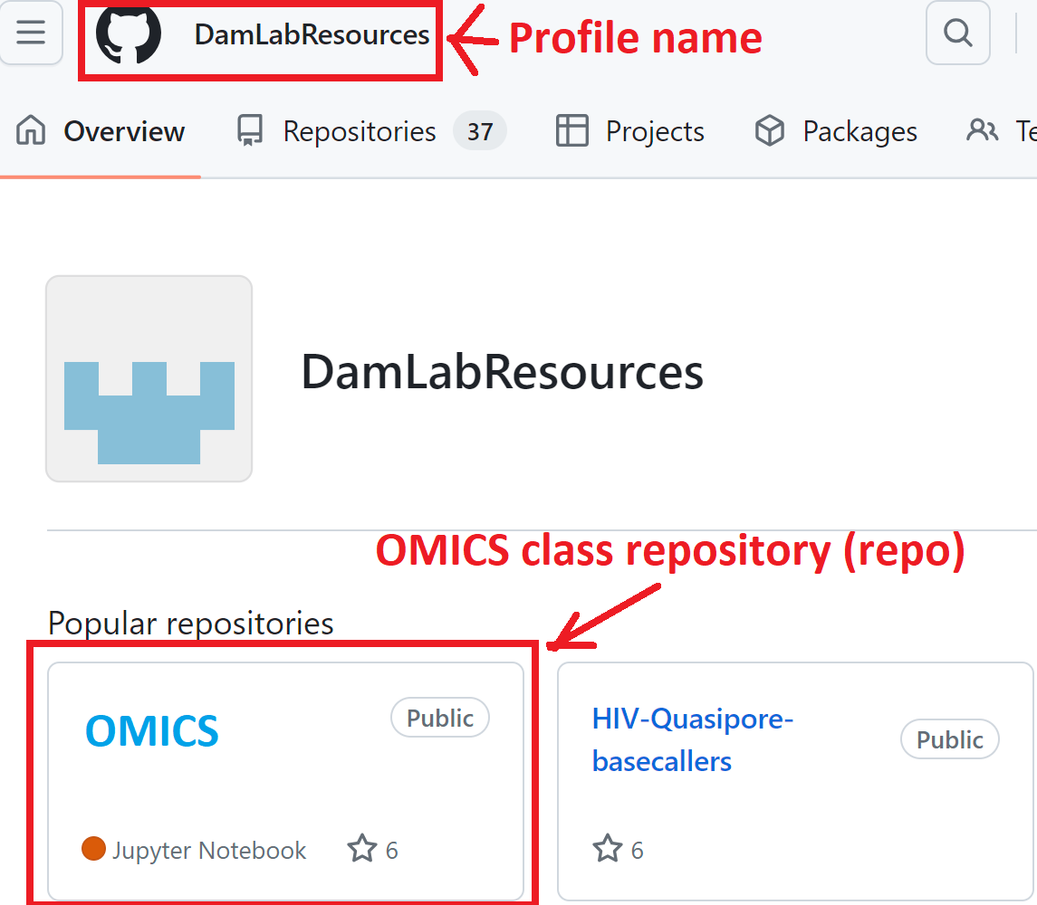
https://github.com/ DamLabResources/OMICS

Slide 15
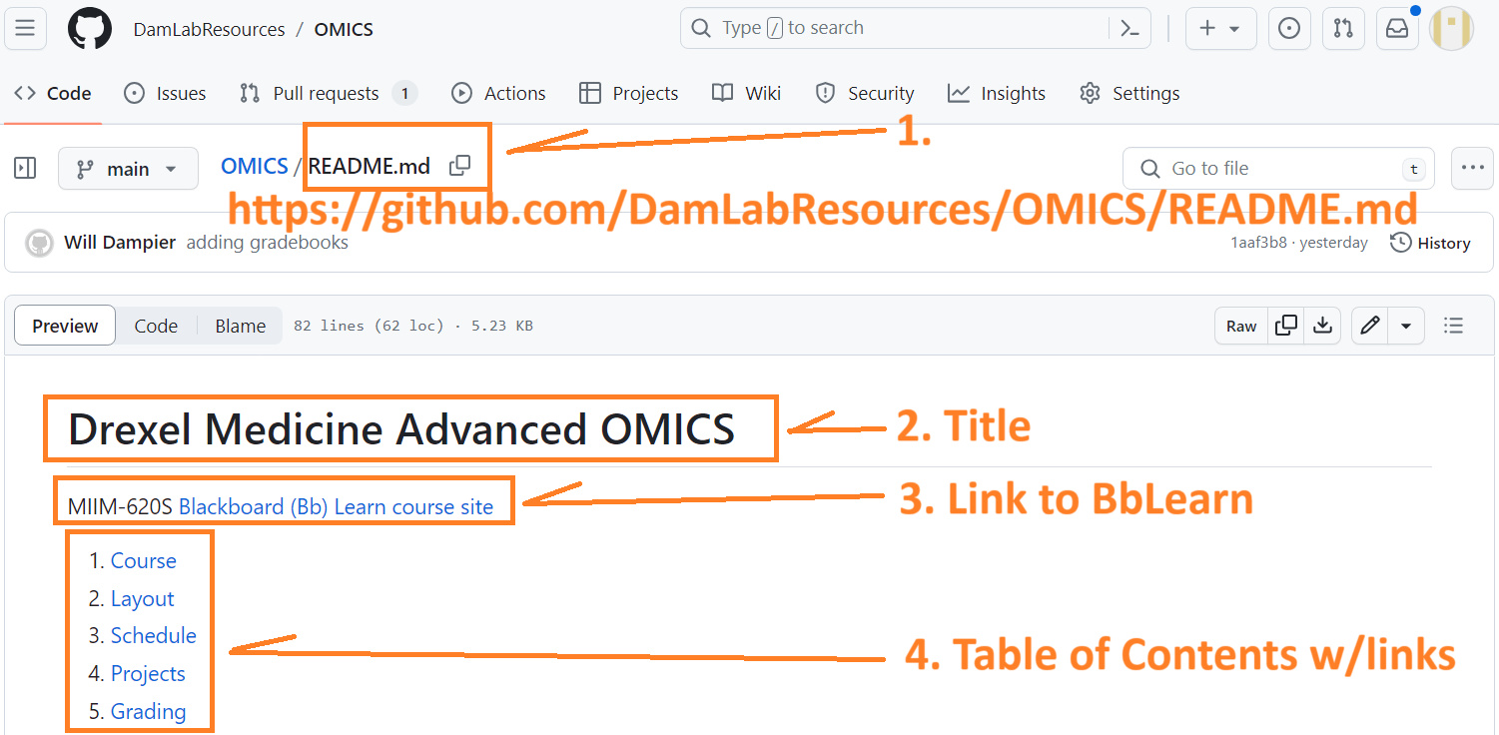
Repo README.md
Notes:
README.md is the first file people look at & says:
Welcome! We are glad you are here
2. Let us show you around

Slide 16
Vocabulary of git: Eight words
Repo
Fork
git clone
git commit
git status
git diff
git push
Pull Request (PR): Very Prestigious. Resume worthy

Slide 17
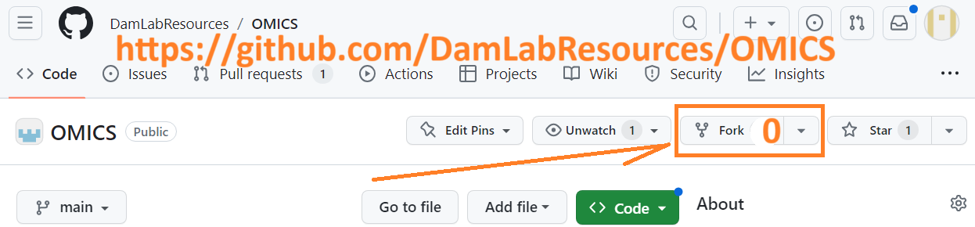
What happens when you click on "fork?"

Slide 18
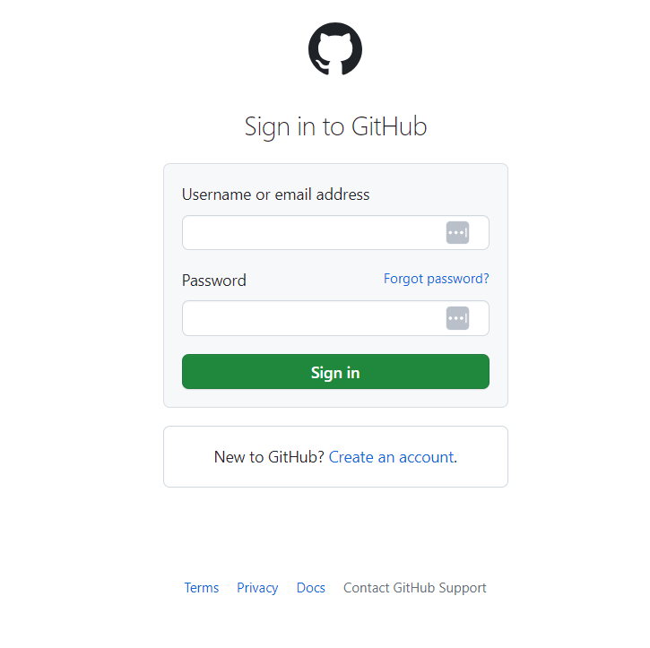
Time to make a GitHub login!
Best practices for choosing a Git name:
Professional
First initials plus last name
Fun!
Easy to remember
Individual to you
Techy or gamer style

Slide 19
Let's try this again- NOW what happens when you click "fork"?

Slide 20
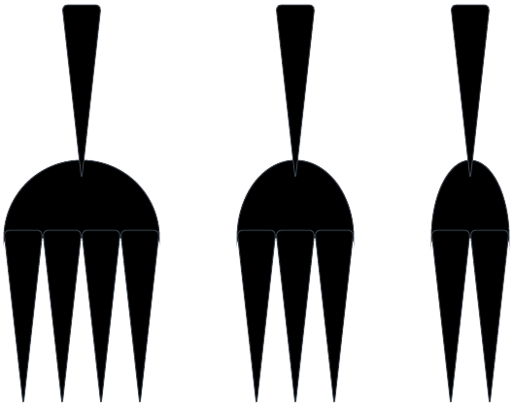
Fork

Slide 21
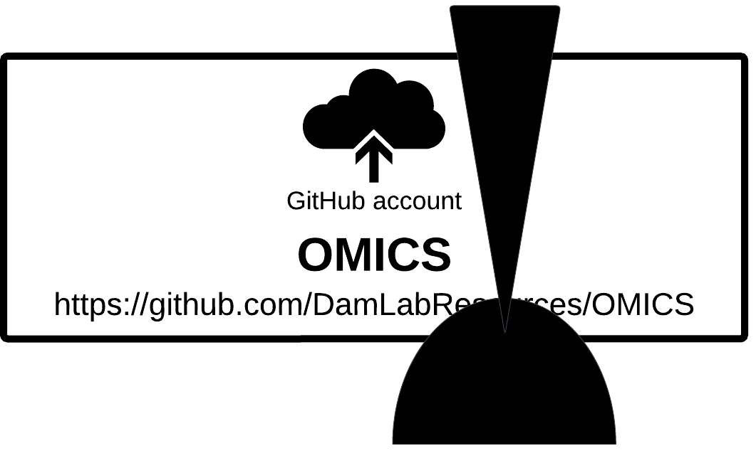
Zero Forks = 0 tines on the fork

Slide 22
Make a fork (copy)
Make a GitHub account (or sign in if you have one already) and click the "fork" button on the OMICS repo.
What happens?
Notes:
Have them go onto github and make an account. Go to the omics repo, and hit the fork button. What happened? When they go back to their own account, what do they now see? Open the forked repo. Does it look the same as the one on Will's page? What does their screen look like now? Any changes?

Slide 23
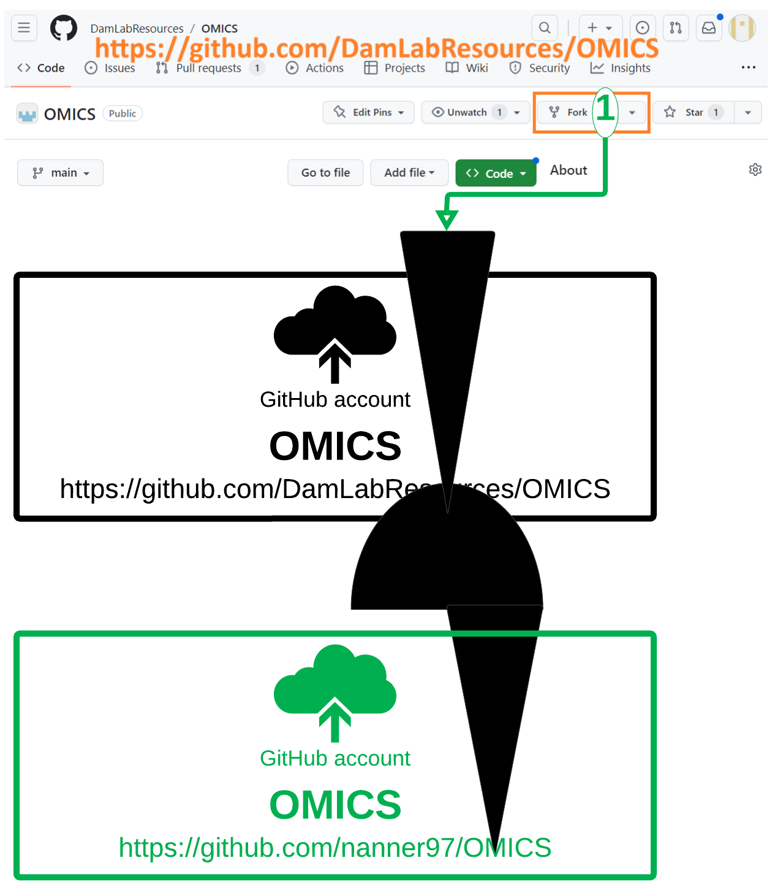
Fork

Slide 24
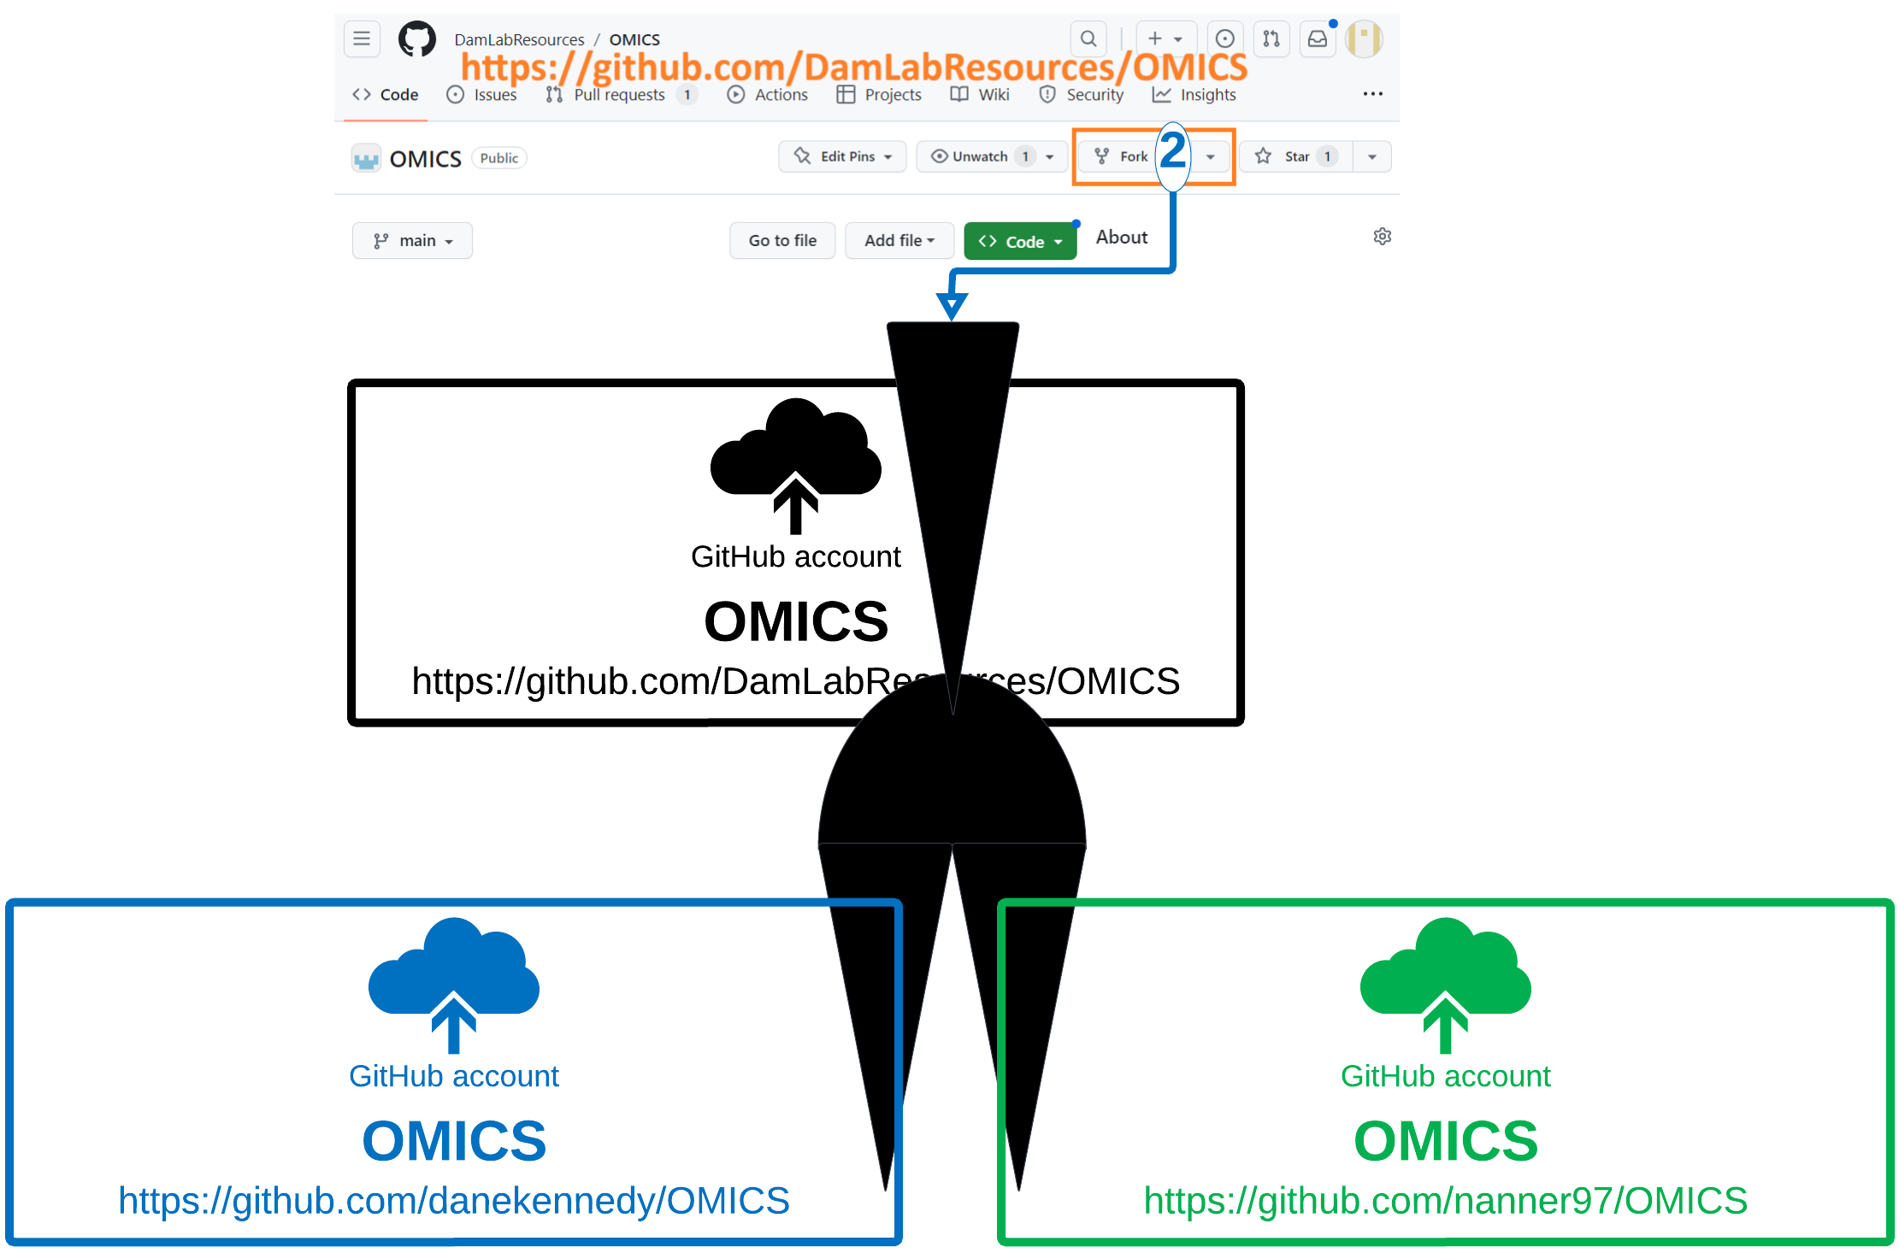
Fork
Notes:
Sam, can you see what is on someone else's page?
This fork on your account is for your eyes only, until you decide to share changes that you make to it. This is YOUR copy, you can personalize it however you want!!!
This is a LIVE document, not a textbook! Things are not set in stone.

Slide 25
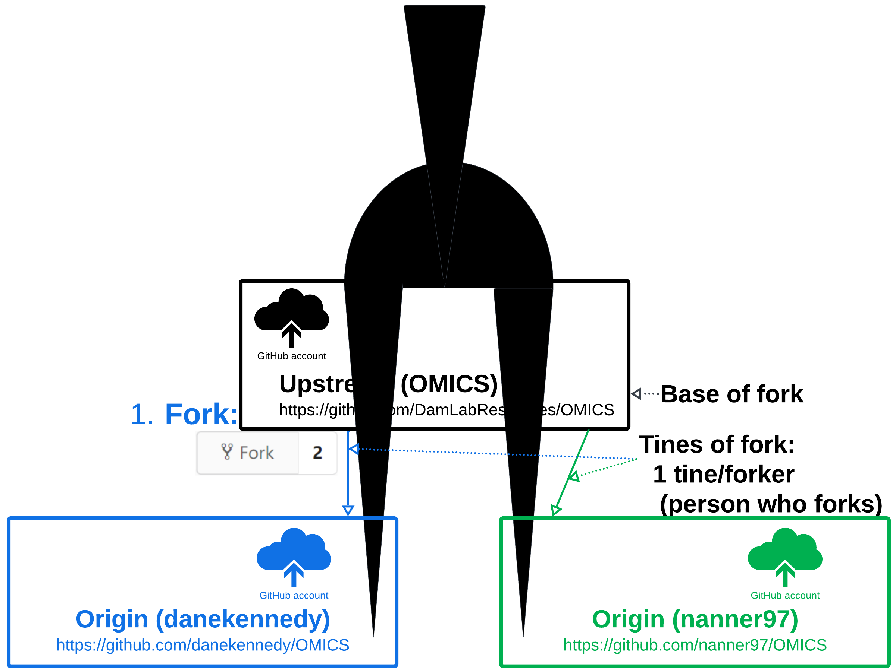
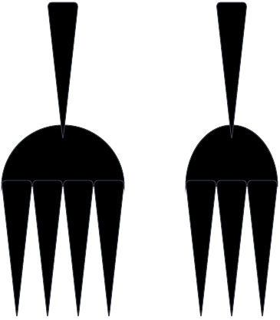
Fork: Copy Upstream to Origin
Notes:
Upstream:
Origin:

Slide 26
Vocabulary of git: Eight words
Repo # Project, Repository storing project
Fork # Copy
git clone
git commit
git status
git diff
git push
Pull Request (PR): Very Prestigious. Resume worthy

Slide 27
Lab Activity 1: Log in to JupyterHub
JupyterHub: Computing on the web!
Coding doesn't happen on GitHub- it happens elsewhere, and gets uploaded to GitHub
In this case, we use a web-based program called JupyterHub
Lab activity 1:
Get VPNed (https://vpn.drexel.edu/) into the network (drexelmed.edu)
Create an account into the MistakeNot server: http://10.11.19.48/
JupyterHub- username and password (use your git login name)
Now- welcome to Linux Land: File->New->Terminal

Slide 28
Vocabulary of git: Eight words
Repo: Upstream, Origin, & Local
Fork: # Copy Upstream -> Origin
git clone [URL] # Copy Origin -> Local
git commit
git status
git diff
git push
Pull Request (PR): Very Prestigious. Resume worthy

Slide 29
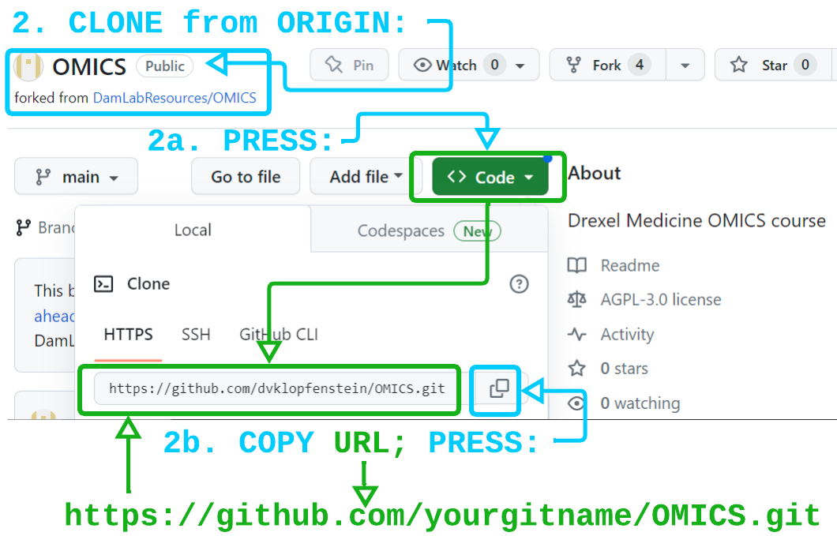
$ cd ~/repos $ git clone [URL]

Slide 30
Fork once
Notes:
Introduce concept of origin, upstream, and local. Where are each of your files that you've been working with. Where is the original repo? Where is your forked repo? Where is the README you just made?

Slide 31
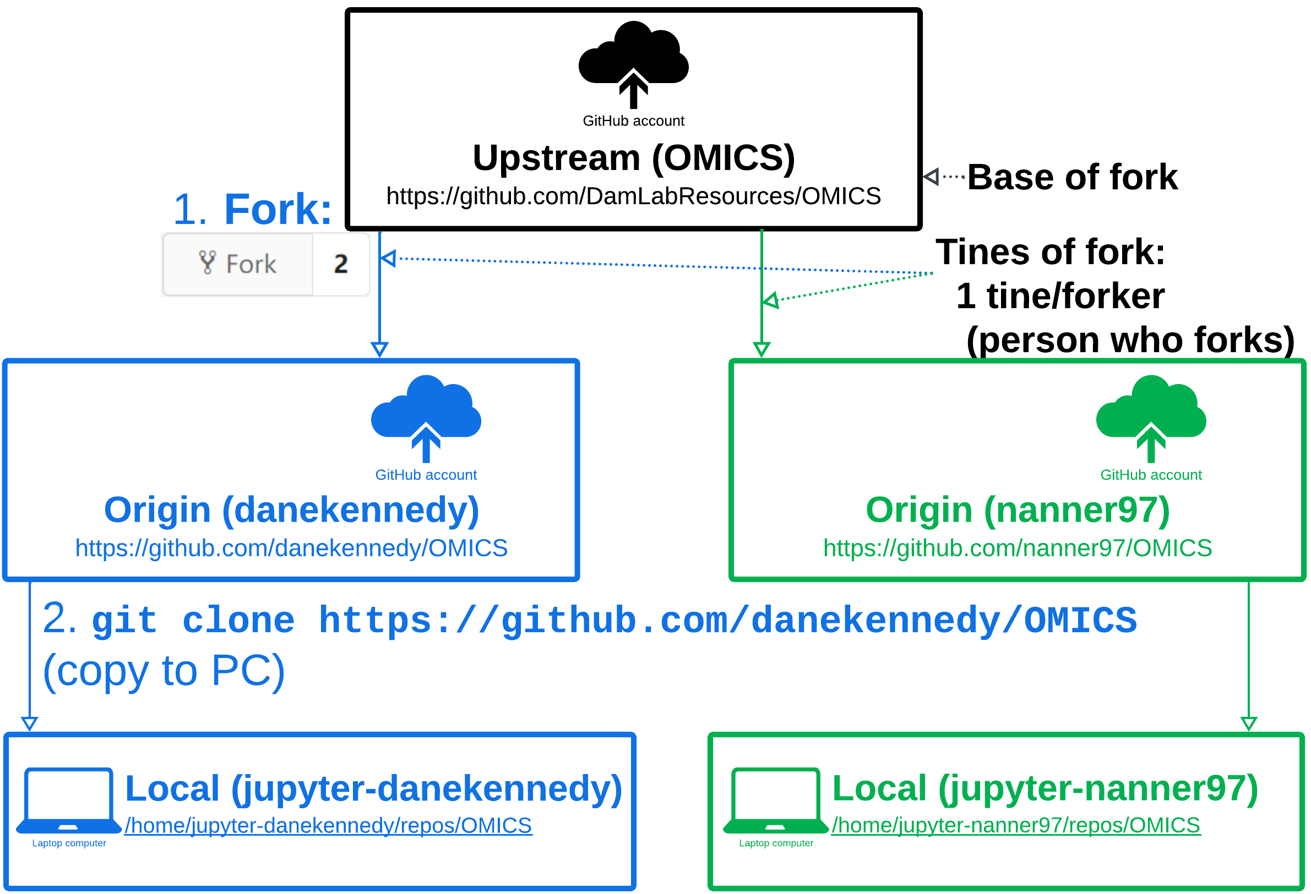
2. Clone once
Notes:
Introduce concept of origin, upstream, and local. Where are each of your files that you've been working with. Where is the original repo? Where is your forked repo? Where is the README you just made?

Slide 32
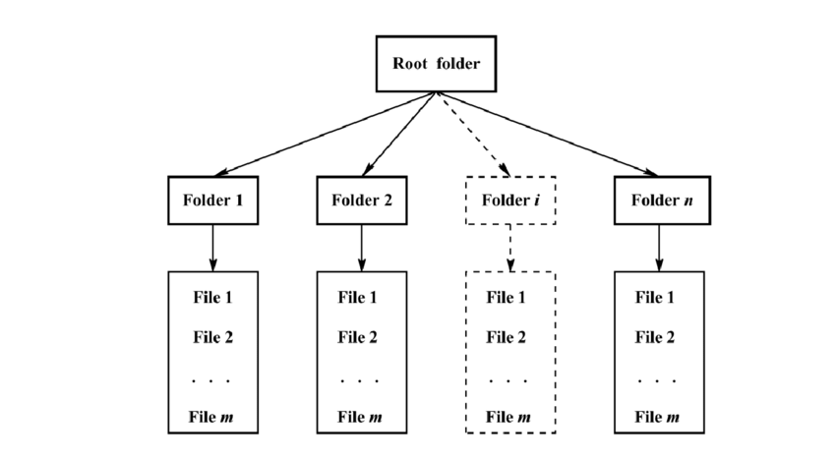
Linux and File Systems
Origin
https://www.researchgate.net/publication/350296947_Assessment_of_Construction_Materials_Trends_Salt_Content_from_Scanned_Images
Notes:
File system graphic- here's what is so useful about Linux- you can manipulate so many files at the same time. You can search through massive directories for the thing you're looking for, you can batch edit files all at once, you don't have to click on a specific thing and edit it and then move onto the next one like you do on a Mac or Windows machine.

Slide 33
Lab activity 2: Welcome to the Command Line
pwd
cd ~/repos/OMICS
ls
ls –help
ls –lrt
ls -lrth
cd
cd repo
cd ~
cd ~/repo/OMICS/projects
Notes:
Walk through each command and see what they do. Have students discuss what they observe

Slide 34
Lab activity 2: Welcome to the Command Line
Create a new directory:
$ mkdir [github_login]
Now we will make a README
What is a README?
Welcome!
We have been expecting you
Let me show you around
$ nano README.md
Notes:
Make sure they navigate to the projects directory to make their README- have them figure out how to get there (and then ask them to show you how they KNOW that they're there (pwd))

Slide 35
Lab Activity 3: "History"
$ history
What happens when you type this command?
Take the output of history and save it in your README
README_[GitHubLogin].md
New commands: history, less

Slide 36
"Peeking" at a file
$ less README_[GitHubLogin].md
$ more README_[GitHubLogin].md
$ head README_[GitHubLogin].md
$ tail README_[GitHubLogin].md
$ echo README_[GitHubLogin].md
$ cat README_[GitHubLogin].md
What do each of these commands do?

Slide 37
Vocabulary of git: Eight words
Repo: Upstream, Origin, & Local
Fork: # Copy Upstream -> Origin
git clone [URL] # Copy Origin -> Local
git commit
git status
git diff
git push
Pull Request (PR): Very Prestigious. Resume worthy

Slide 38
Vocabulary of git: Eight words
Repo: Upstream, Origin, & Local
Fork: Upstream -> Origin
git clone [URL] # Origin -> Local
git commit
git add
git status
git diff
git push
Pull Request (PR): Very Prestigious. Resume worthy
Notes:
THEN, commit/push to git, and then back to the git section

Slide 39
JupyterHub- commit your README
Where is it? What happened when you committed it?

Slide 40
Vocabulary of git: Eight words
Repo: Upstream, Origin, & Local
Fork: Upstream -> Origin
git clone [URL] # Origin -> Local
git commit #
git add README_mygitlogin.md #
git status #
git diff #
git push
Pull Request (PR): Very Prestigious. Resume worthy
Notes:
THEN, commit/push to git, and then back to the git section

Slide 41
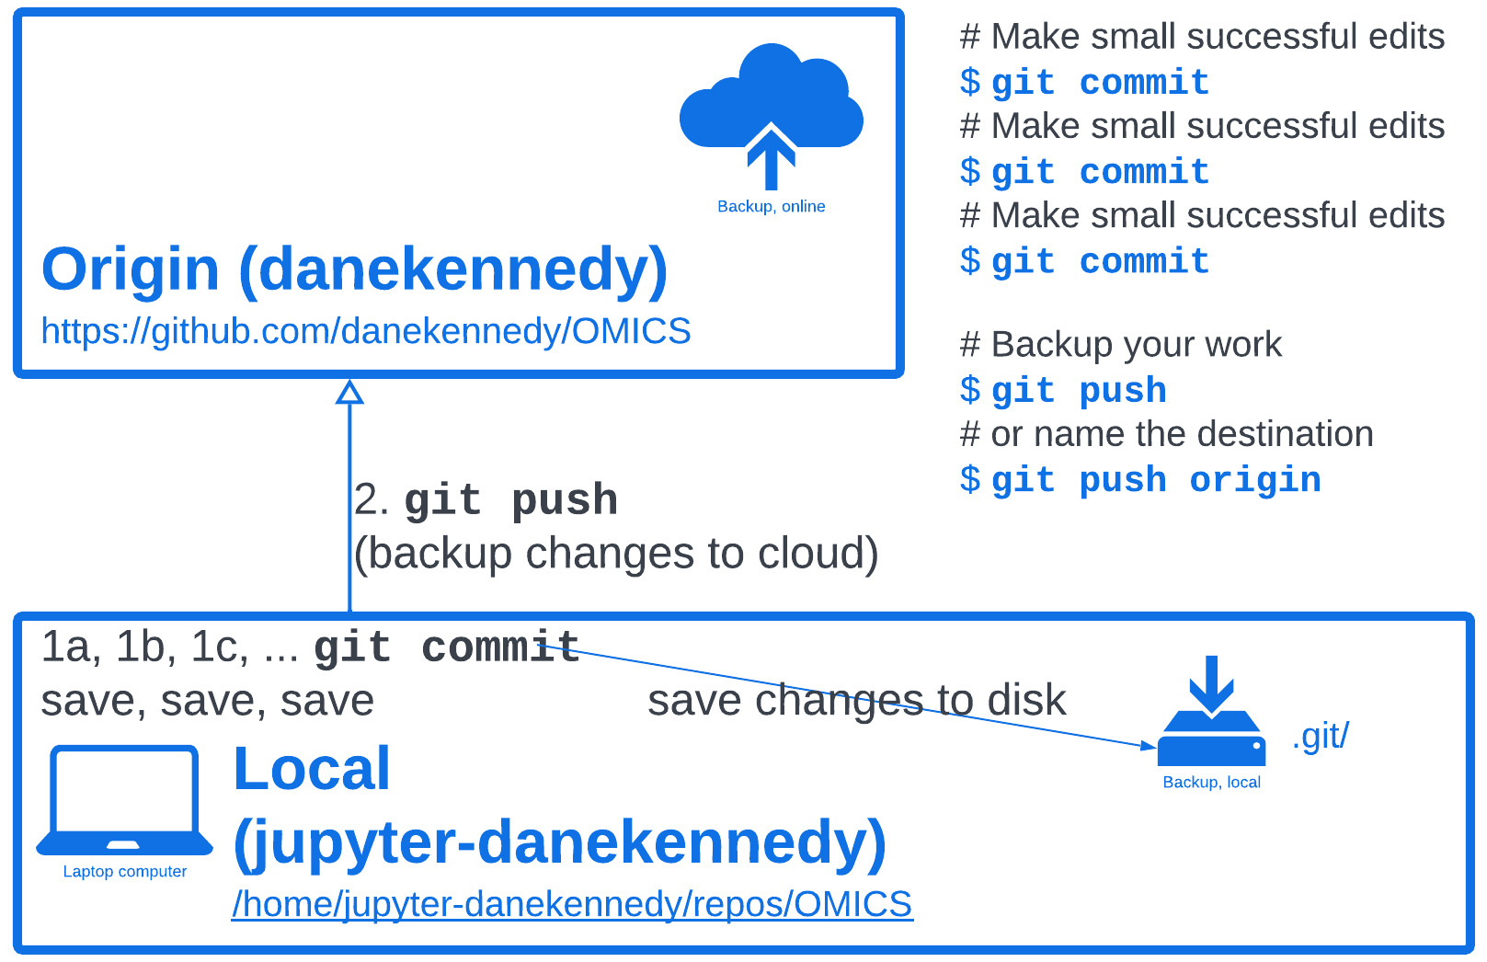
Daily Flow

Slide 42
Git push- where are my files NOW?
Go to origin and check out if anything has changed!

Slide 43
Git add, commit, push
$ cd ~/repos/OMICS/project/[mygitlogin]
Make a new file: README.md
$ git add README.md
Edit README.md
$ git commit !$ --message 'My README'
$ git commit README.md -m 'My README'
$ git commit –help
$ git push
Go look: https://github.com/danekennedy/OMICS/doc
Notes:
Lab activity 4

Slide 44
Vocabulary of git: Eight words
Repo: Upstream, Origin, & Local
Fork: Upstream -> Origin
git clone [URL] # Origin -> Local
git commit # Local -> repo_name/.git
git status # New, Modified, Untracked
git diff # Show lines Added/Deleted
git push # repo_name/.git -> Origin
Pull Request (PR): Very Prestigious. (next week!)

Slide 45
Your project README.md
Add it here:
OMICS/projects/[yourgithubname]/README.md

Slide 46
Your Independent Project
Analyze genomic data week-by-week
Week 1:
Understand the file structure of the OMICS course project stored in GitHub
Download your writable copy of the OMIC course project
Add your sub-directory to OMICS/projects:
OMICS/projects/[yourgithubname]
Create:
OMICS/projects/[yourgithubname]/README.md
Save revisions to your README.md as you develop it
Back-up the work done on your computer to your GitHub account
Notes:
GOA Tools: Collaborators all over the world
Why do we hate group projects?
If someone hasn't done something, I can't do something
END WITH: Big open source world

Slide 47
The End
Homework: Work on Independent Project Week 1

Slide 48
Git slide just on what a commit actually does
Also git add, git status, and git diff.
Have the students use each of these and say what they do.
Where does a file end up after I commit it?

Slide 49
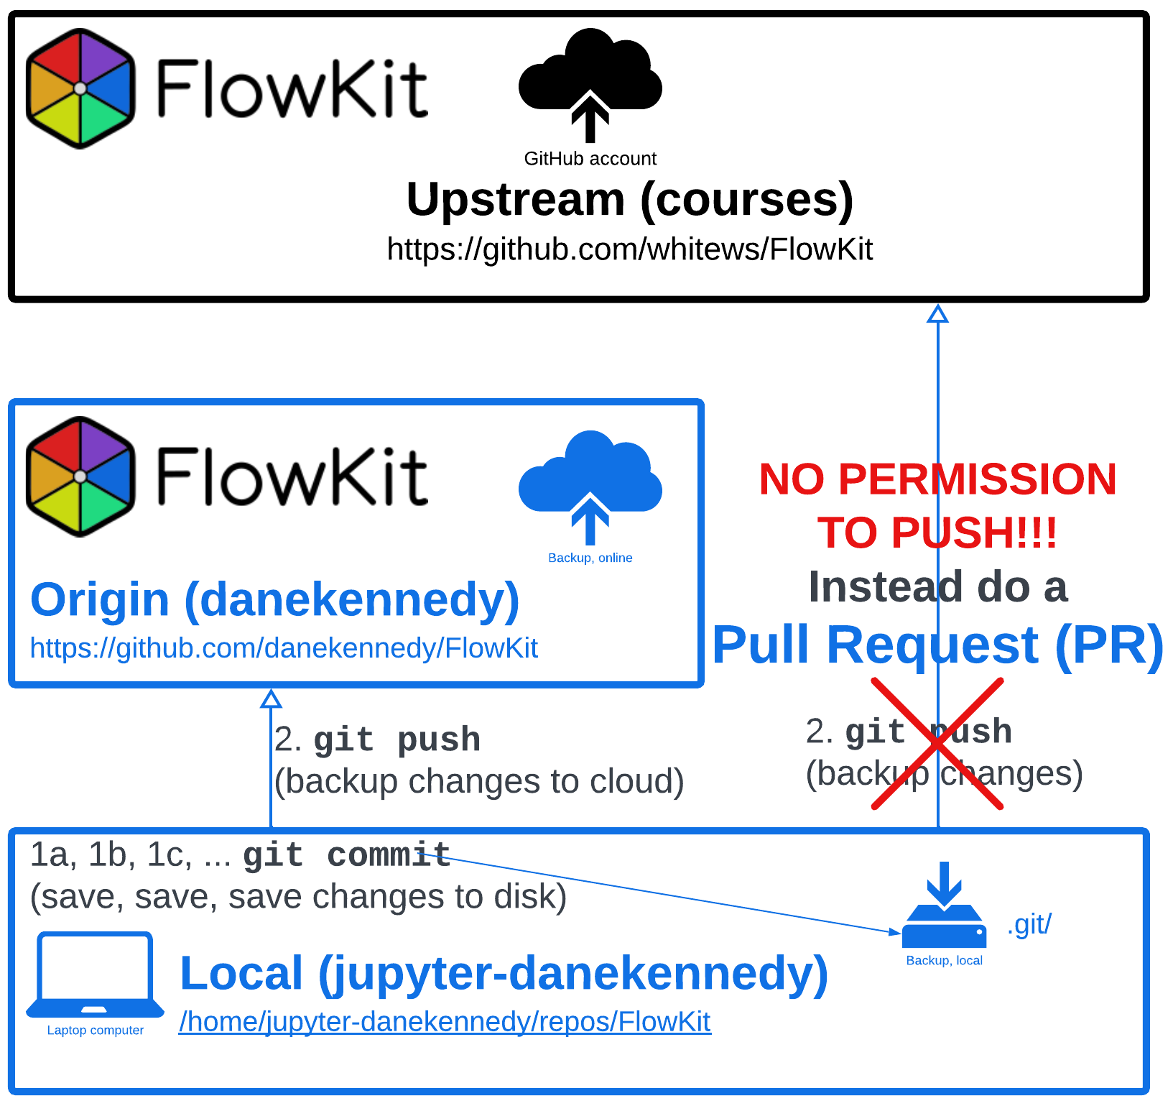
NO PUSHING to Upstream!
Notes:
#### TIME DEPENDENT- continue or stop
**** take a look at OMICS origin- where is your file?
Take a look at your OMICS upstream- where is your file?
Take a look at your origin- where are your classmate's files?
YOU CAN'T SEE EACH OTHERS WORK YET!!!
Before we begin

Slide 50
Vocabulary of git: Eight words
Repo: Upstream, Origin, & Local
Fork: Upstream -> Origin
git clone [URL] # Origin -> Local
git commit # Local -> repo_name/.git
git status # New, Modified, Untracked
git diff # Show lines Added/Deleted
git push # repo_name/.git -> Origin
Pull Request (PR): Very Prestigious. (next week!)

Slide 51
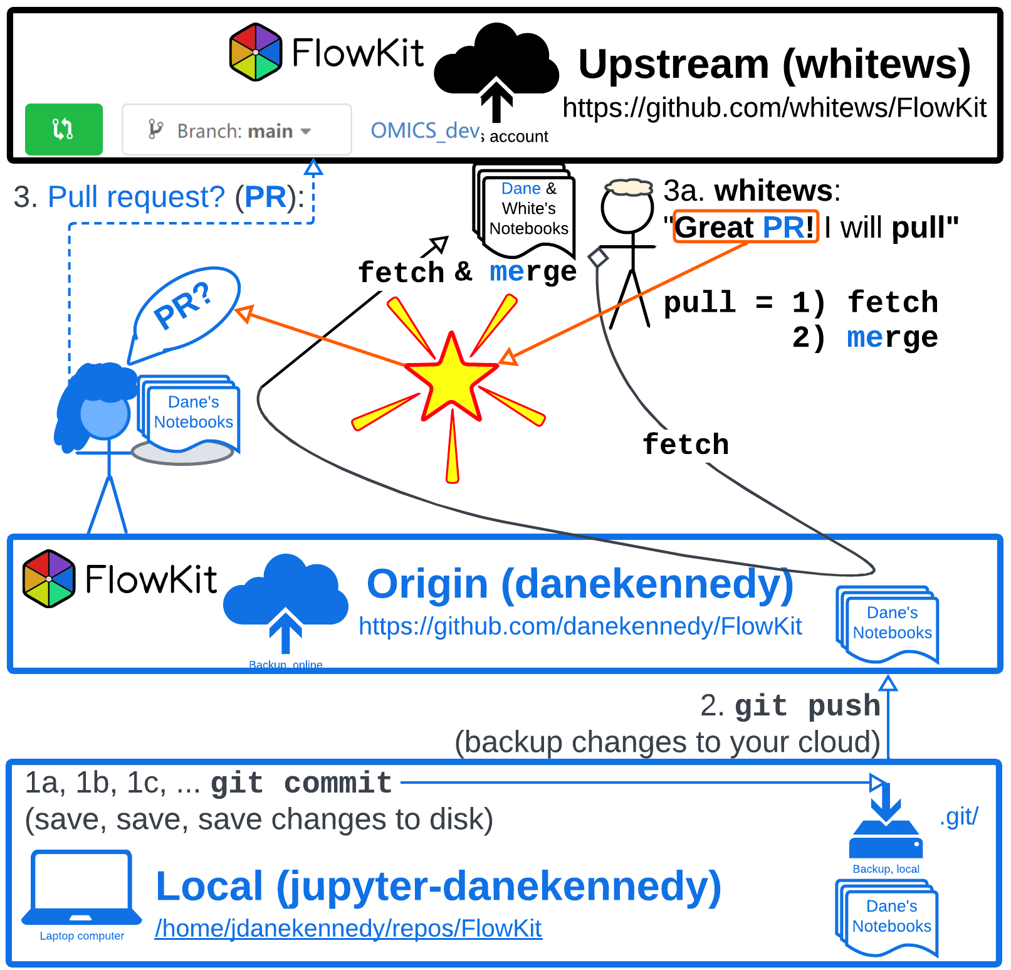
Pull Request (PR) to fetch & merge
Origin PR (danekennedy): "Upstream, will you accept my edits to FlowKit?"
Upstream (whitews): "Great PR! I will PULL & Merge your edits into FlowKit."

Slide 52
Vocabulary of git: Eight words
Repo: Upstream, Origin, & Local
Fork: Upstream -> Origin
git clone [URL] # Origin -> Local
git commit # Local -> repo_name/.git
git status # New, Modified, Untracked
git diff # Lines Added/Deleted
git push # repo_name/.git -> Origin
Pull Request (PR): Very Prestigious. Origin <-> Upstream

Slide 53
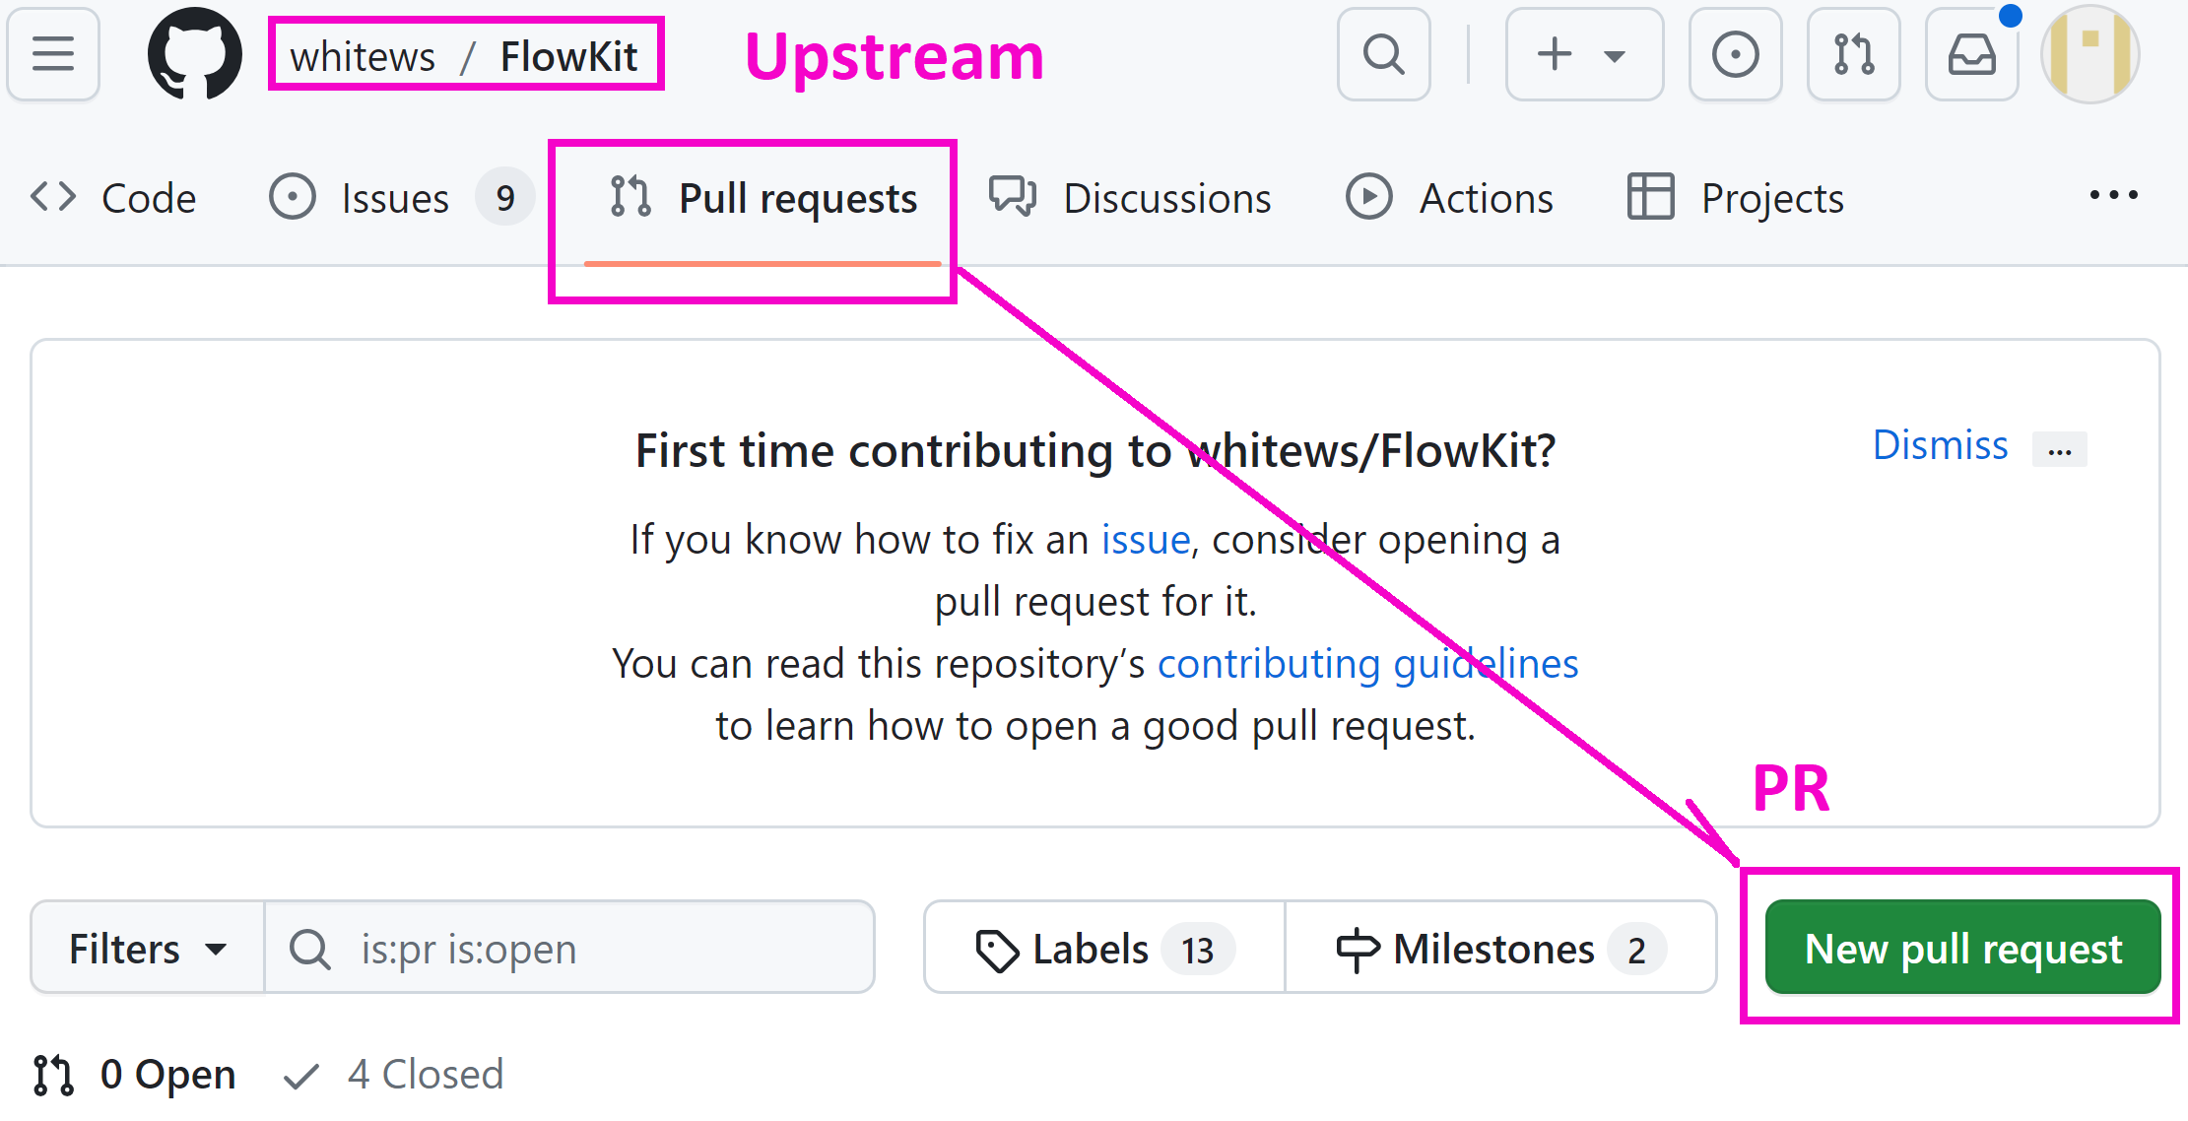
Pull Request
Origin -> Upstream

Slide 54
Vocabulary of git: Eight words
Repo
Fork
git clone
git commit
git status
git diff
git push
Pull Request (PR): Very Prestigious. Resume worthy

Slide 55
Note for kaytie and deb
Ssh/tokens- week 2
Notes:
!$
!^
!*
!:2*
etc

Slide 56
Links
https://blog.hubspot.com/website/what-is-github-used-for

Slide 57
Git config: Set your name and email
$ git config --global user.name "Your Name Comes Here"
$ git config --global user.email you@yourdomain.example.com
For example, to set "NO EMAIL"
$ git config --global user.name "DANE Kennedy"
$ git config --global user.email danekennedy@users.noreply.github.com
$ git config --list

